Slide 1
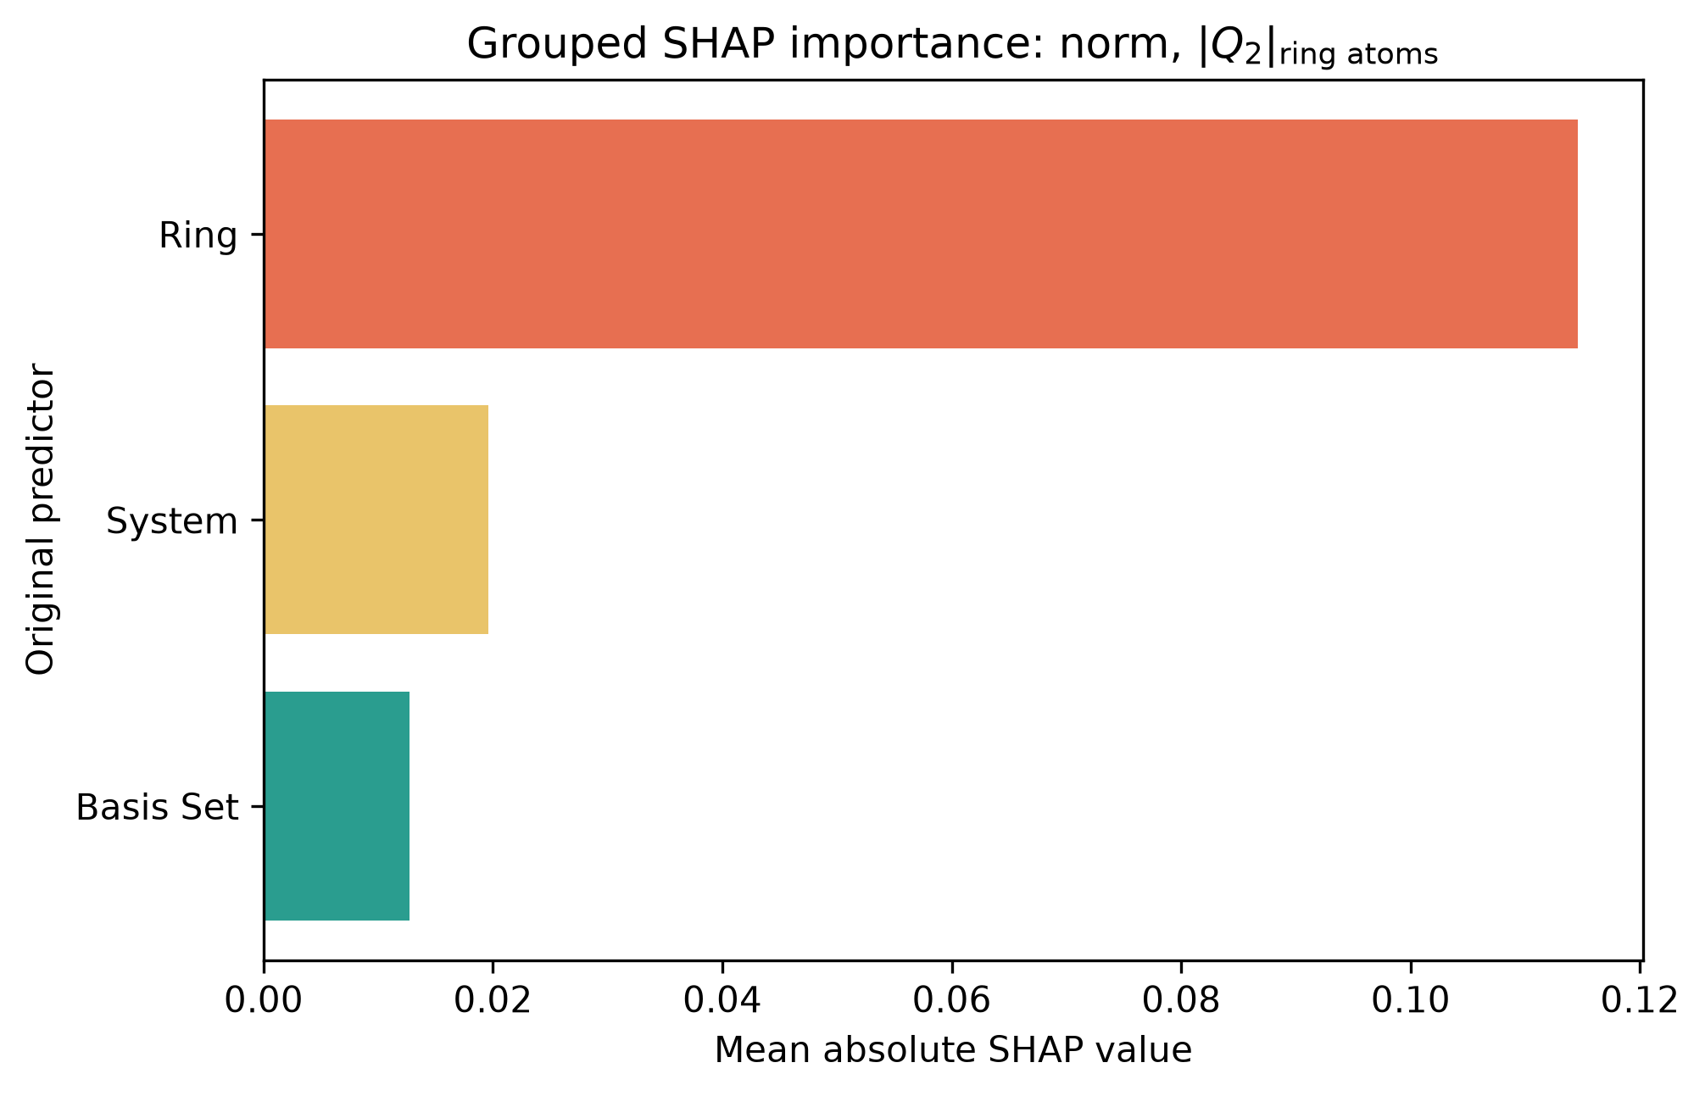
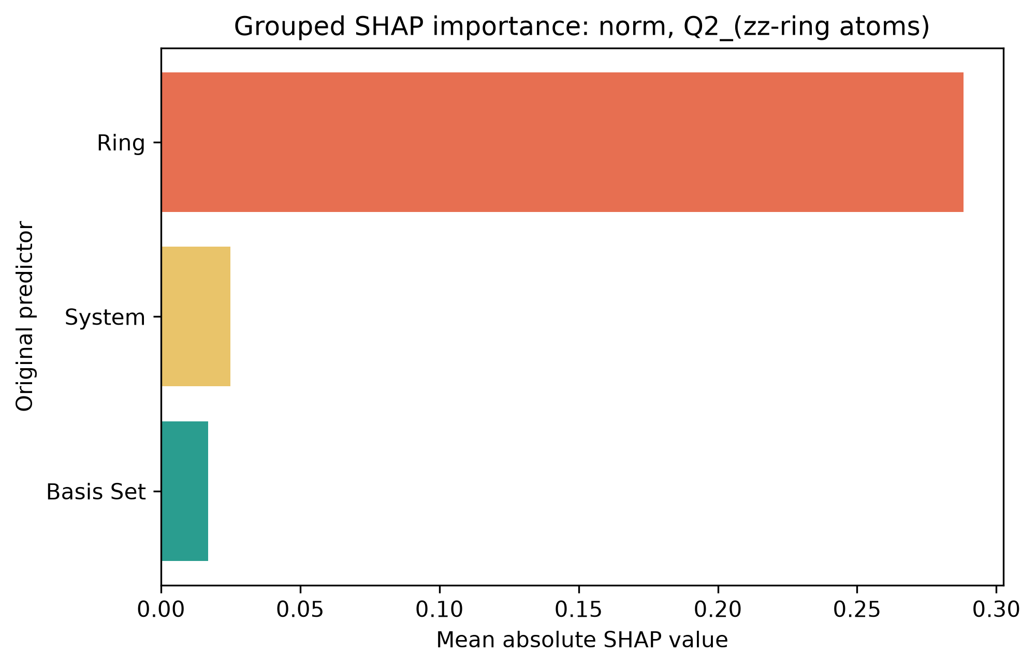
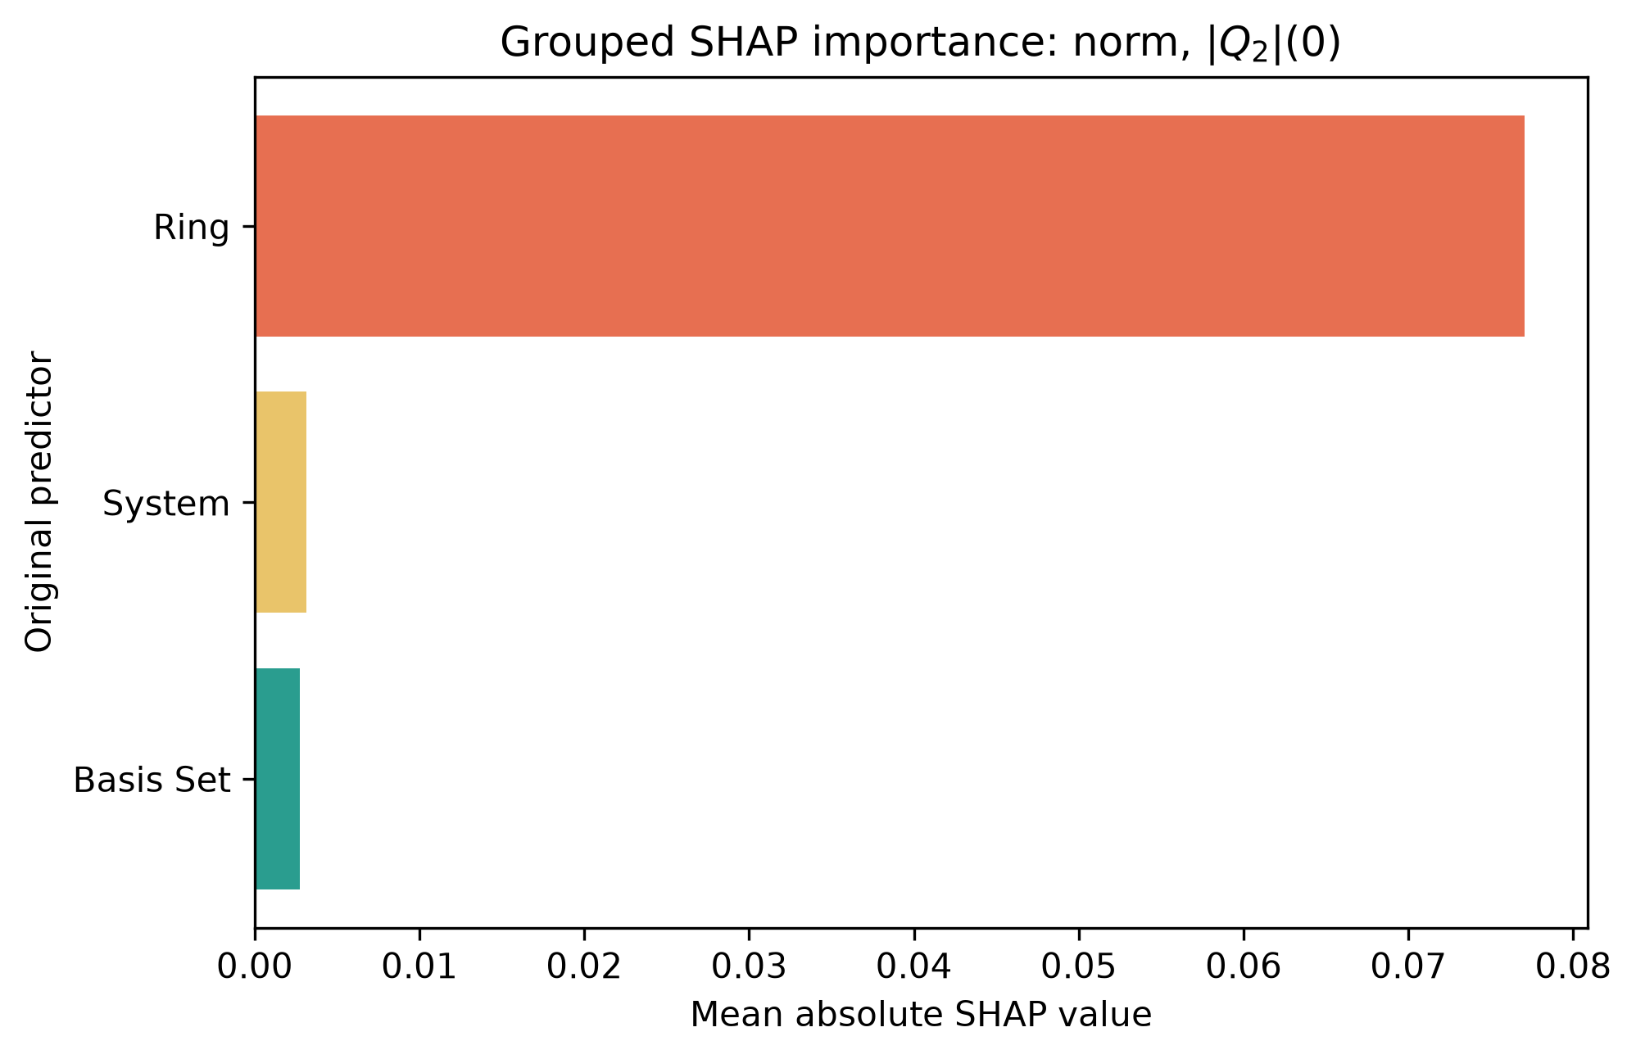
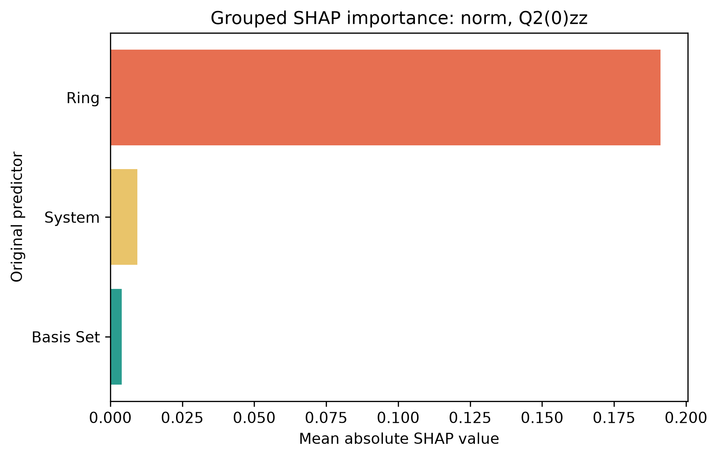
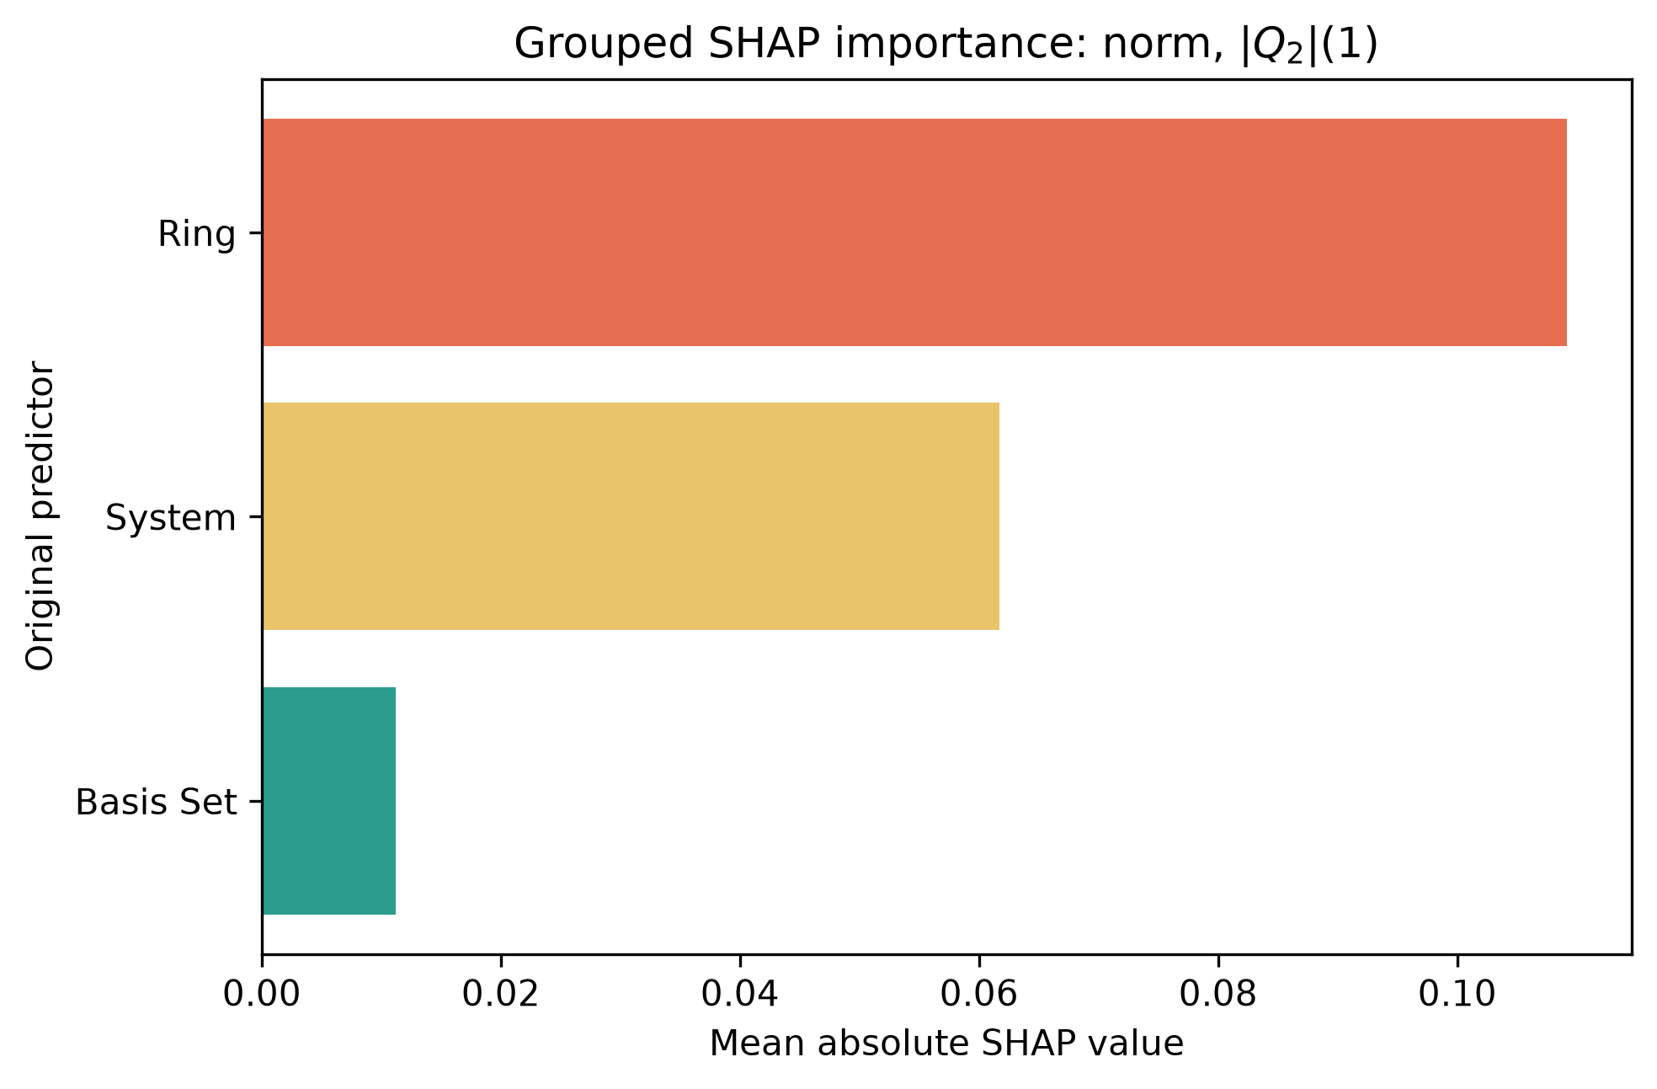
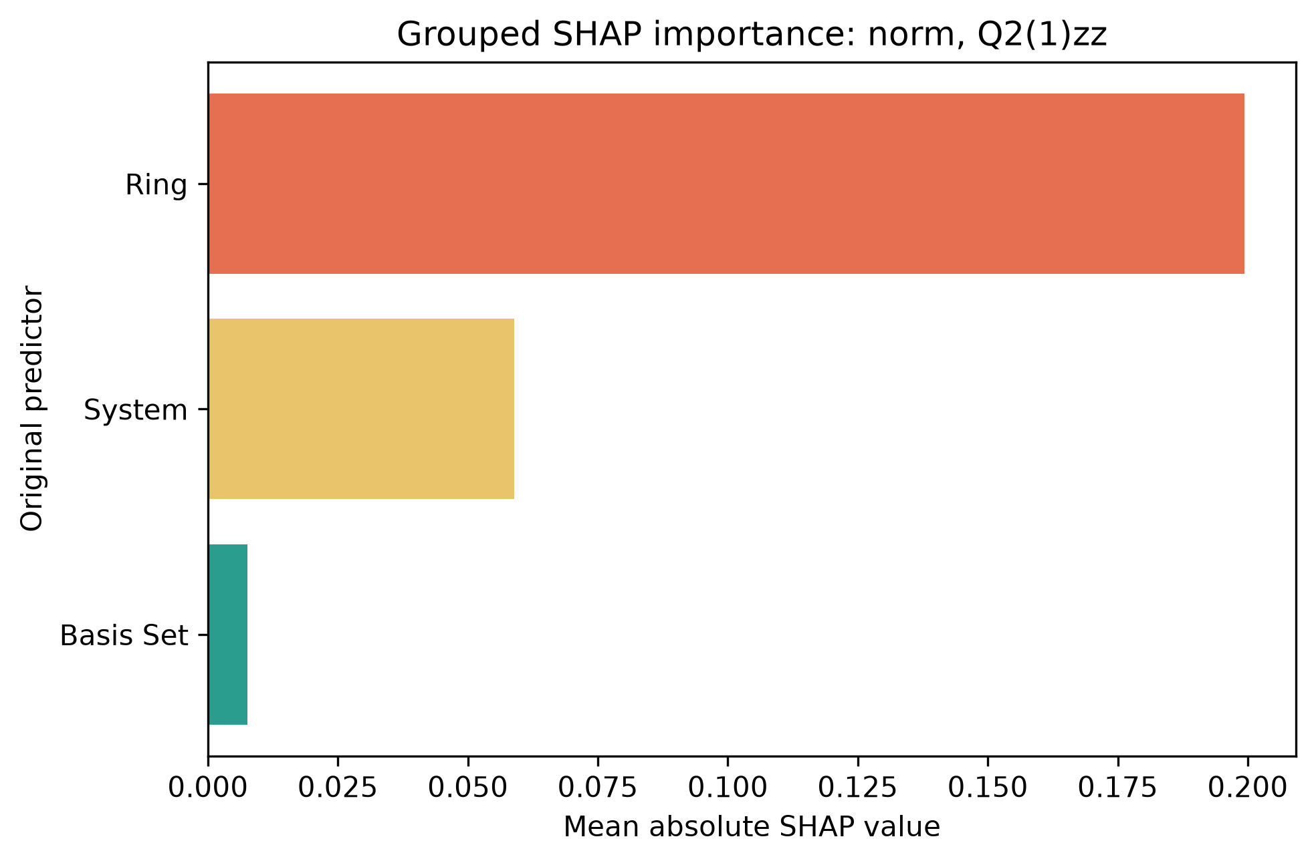
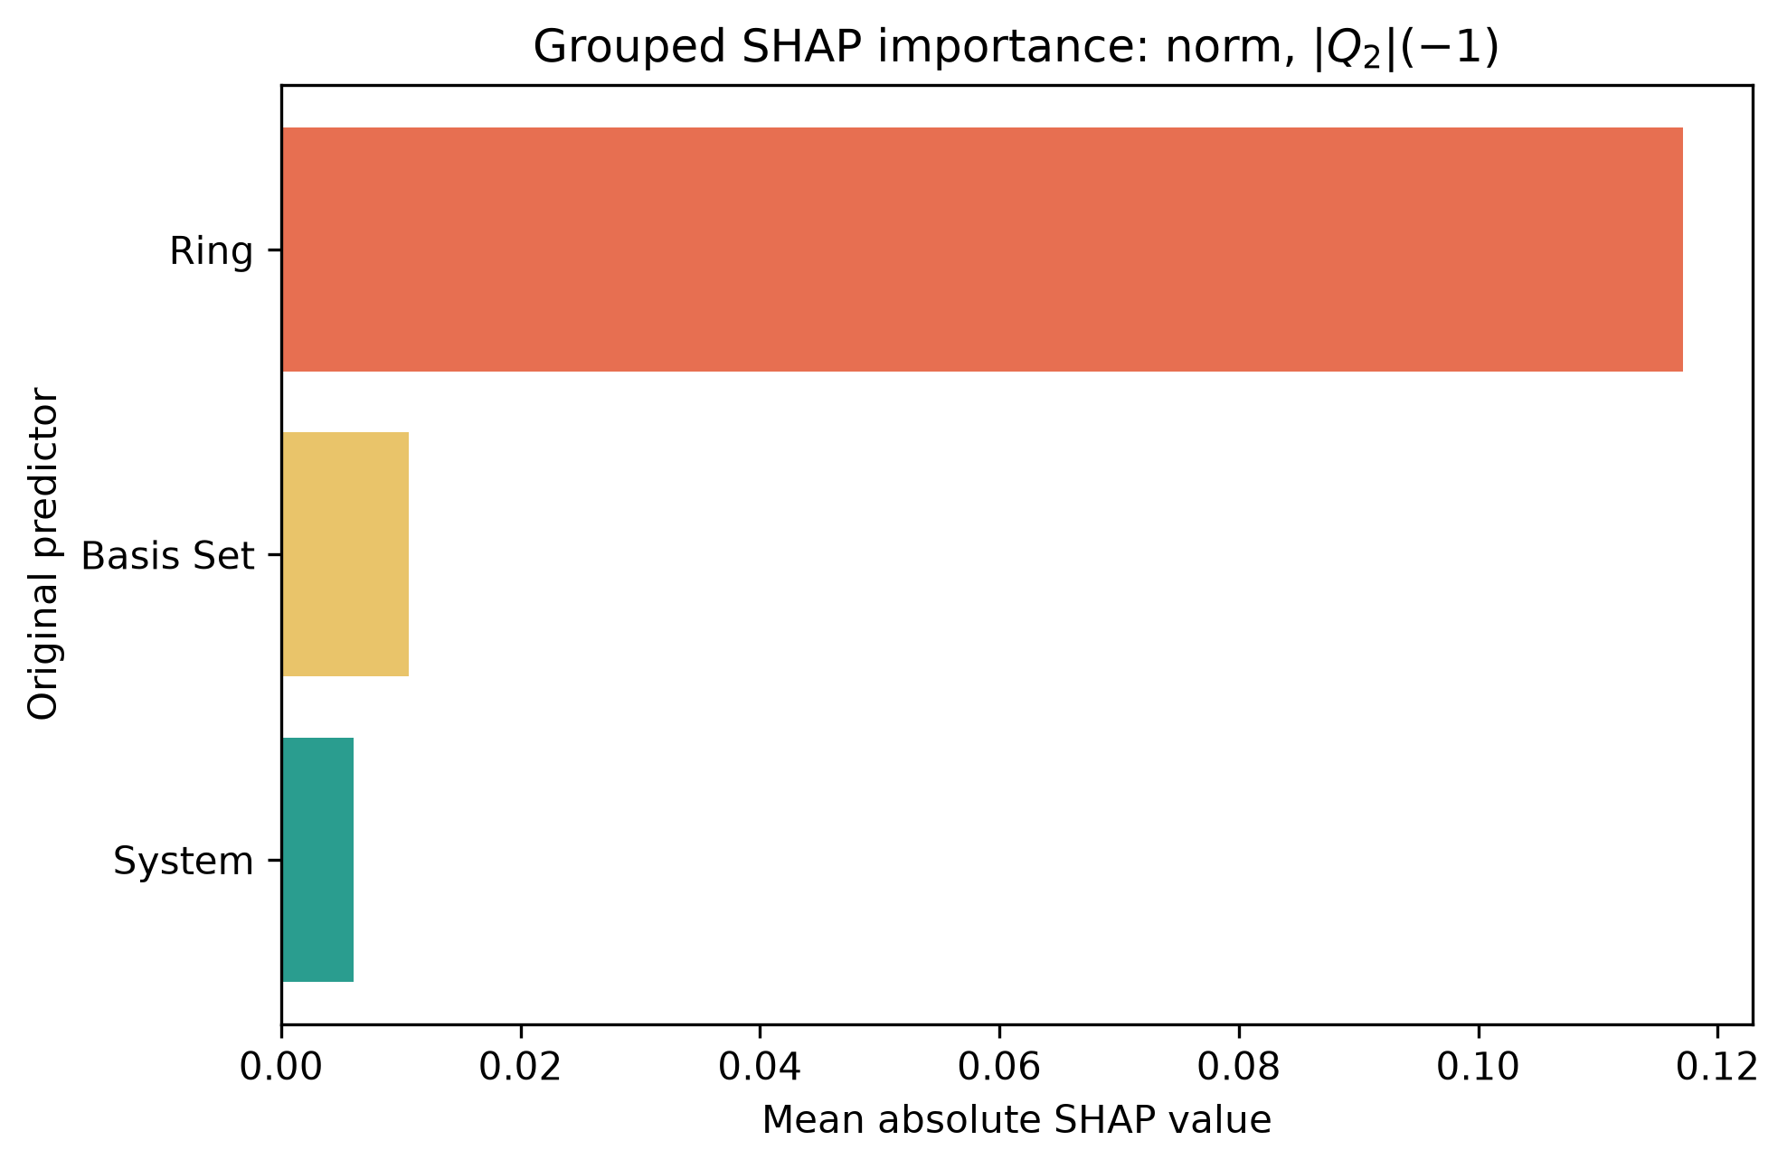
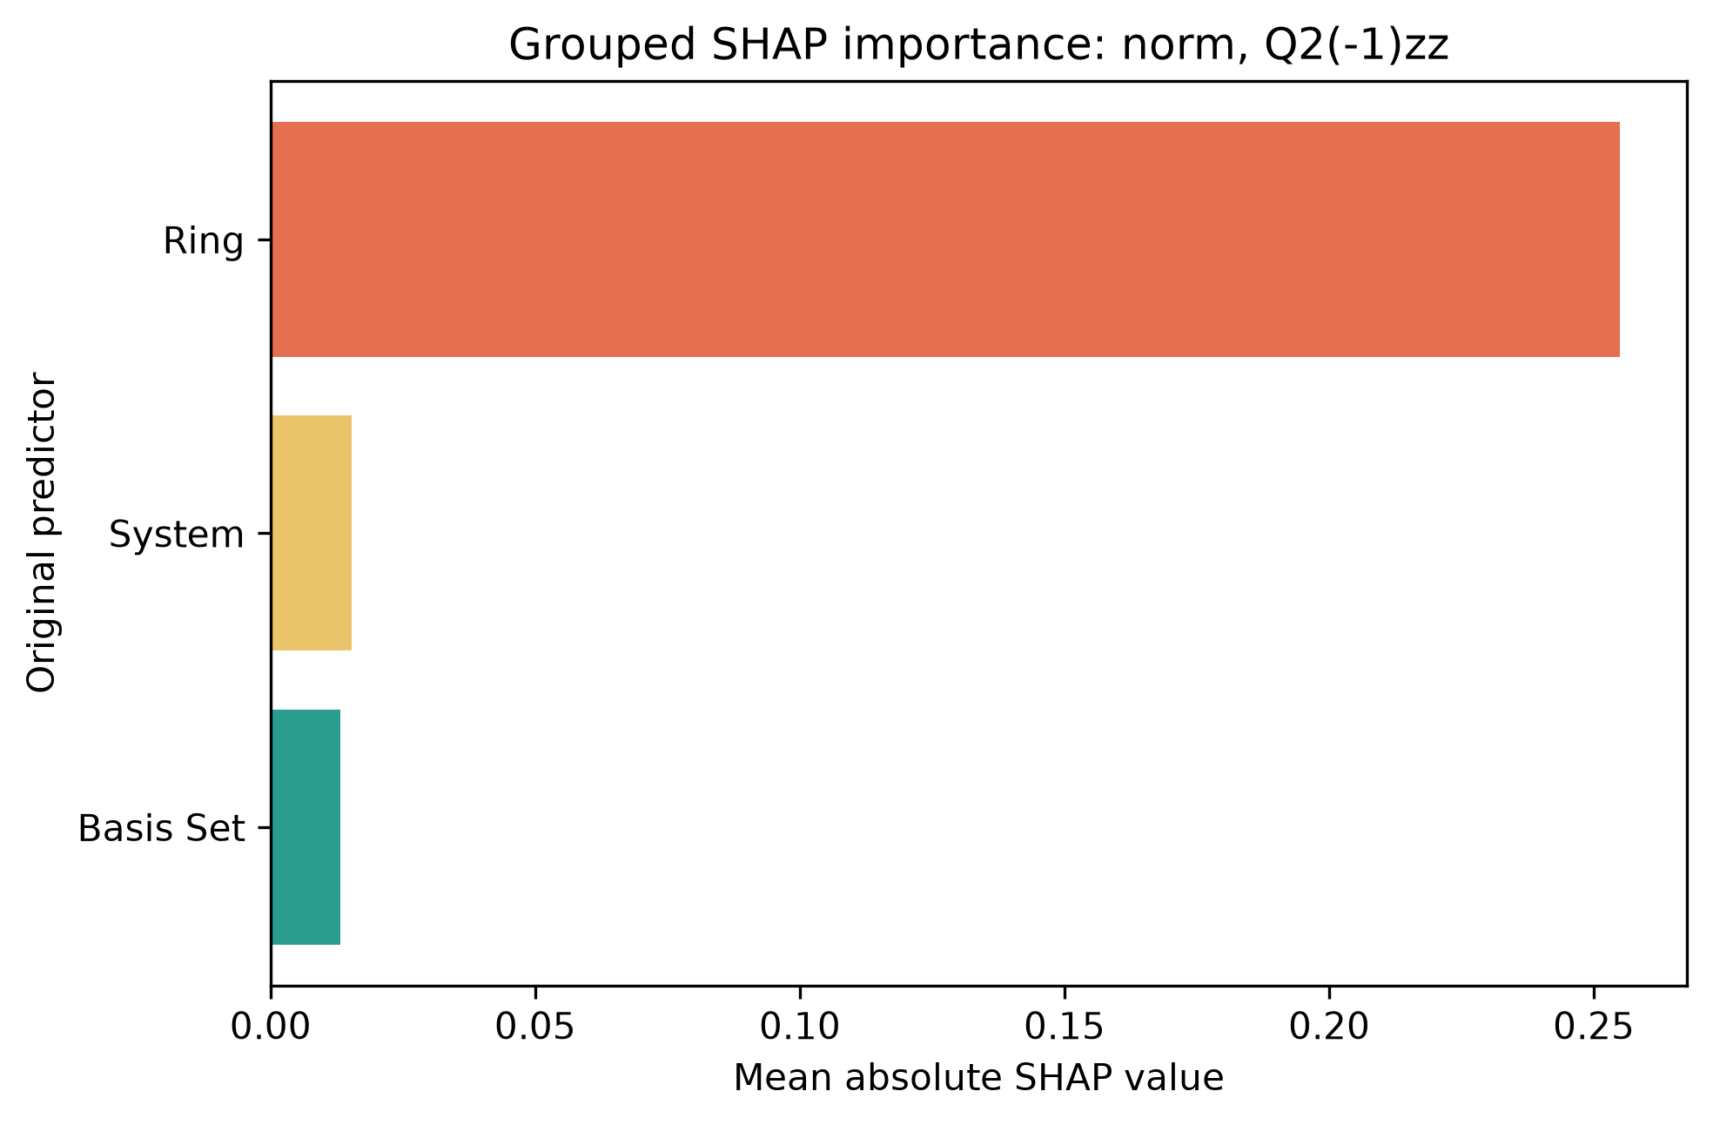








a)
$${\left|Q_{2}\right|}_{ring atoms}$$
b)
$$Q_{2_{zz},ring atoms}$$
c)
$$\left|Q_{2}\right|\left(0\right)$$
d)
$$Q_{2}{\left(0\right)}_{zz}$$
e)
$$\left|Q_{2}\right|\left(1\right)$$
f)
$$Q_{2}{\left(1\right)}_{zz}$$
g)
$$\left|Q_{2}\right|(−1)$$
h)
$$Q_{2}{\left(−1\right)}_{zz}$$

Slide 2
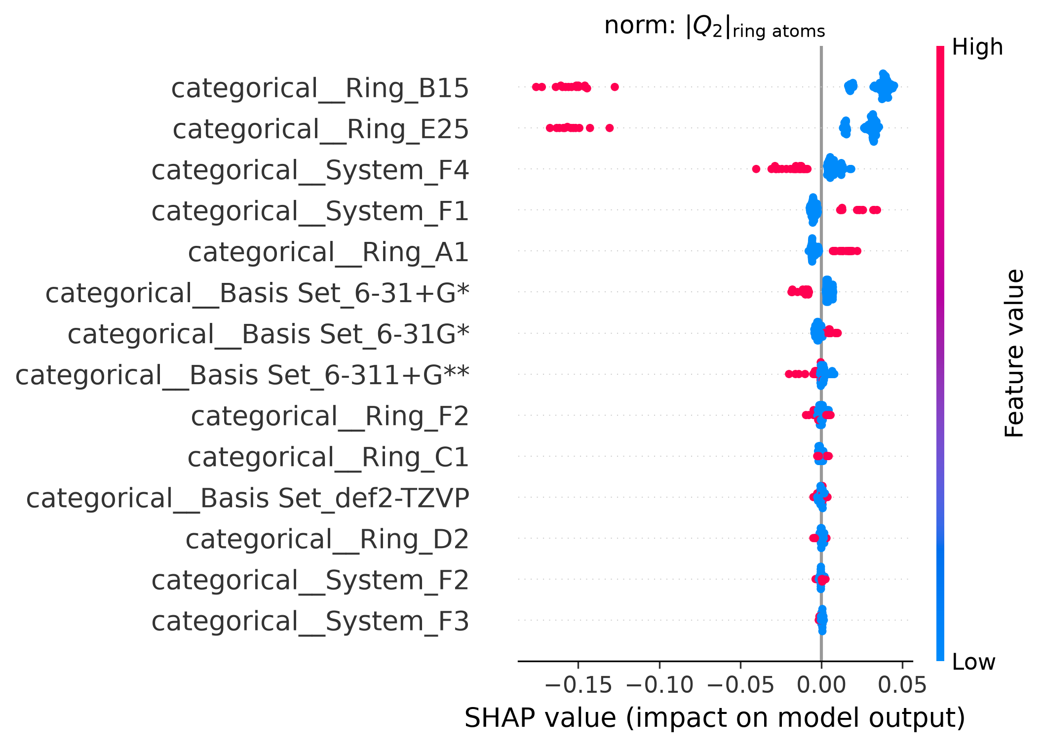
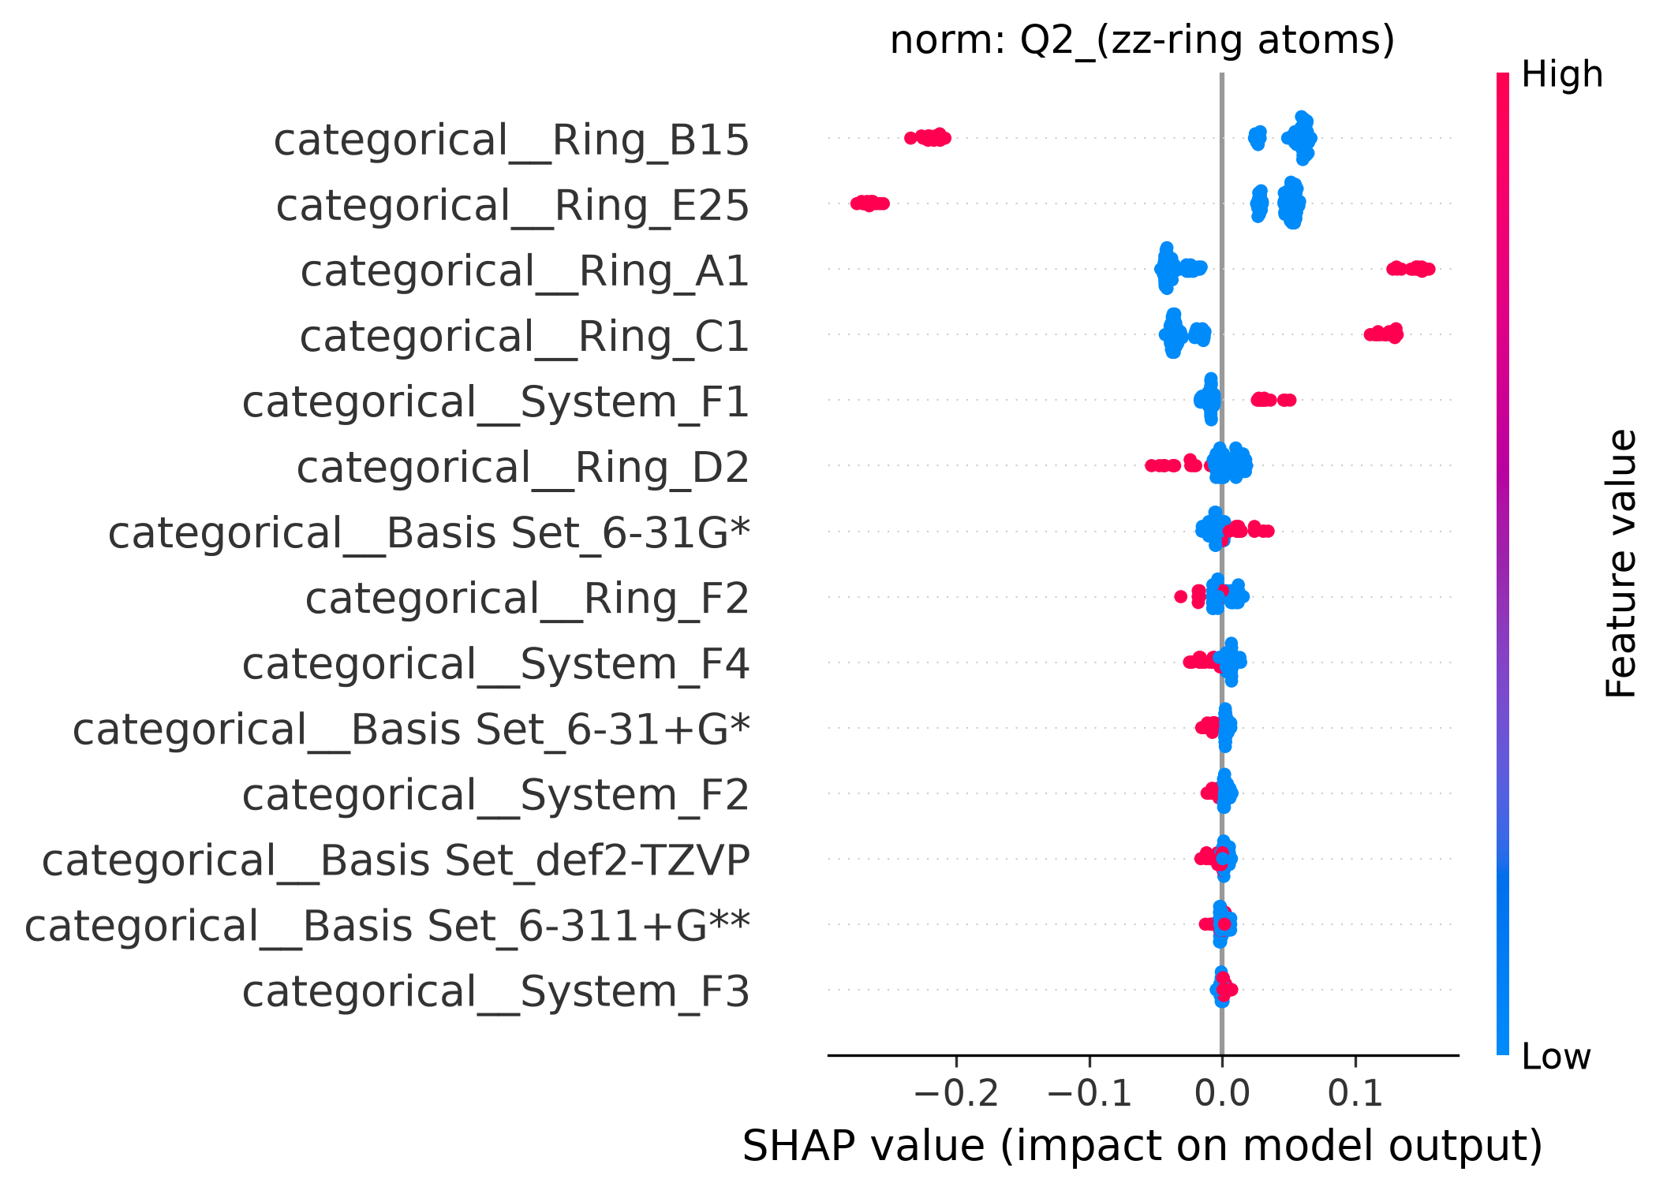
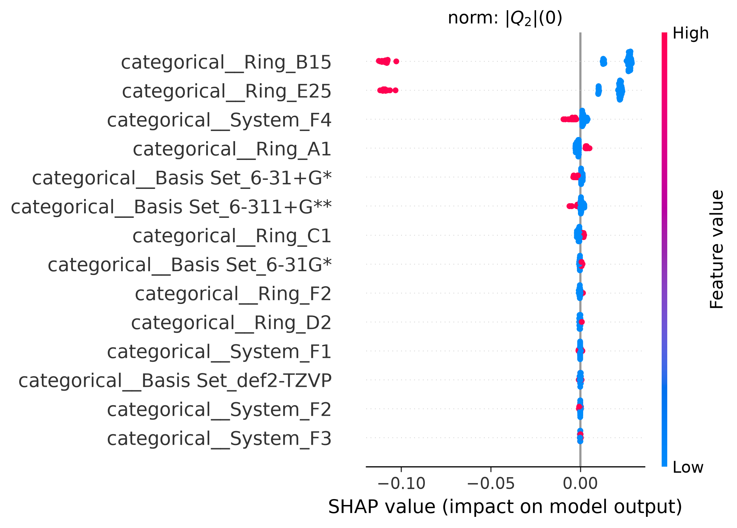
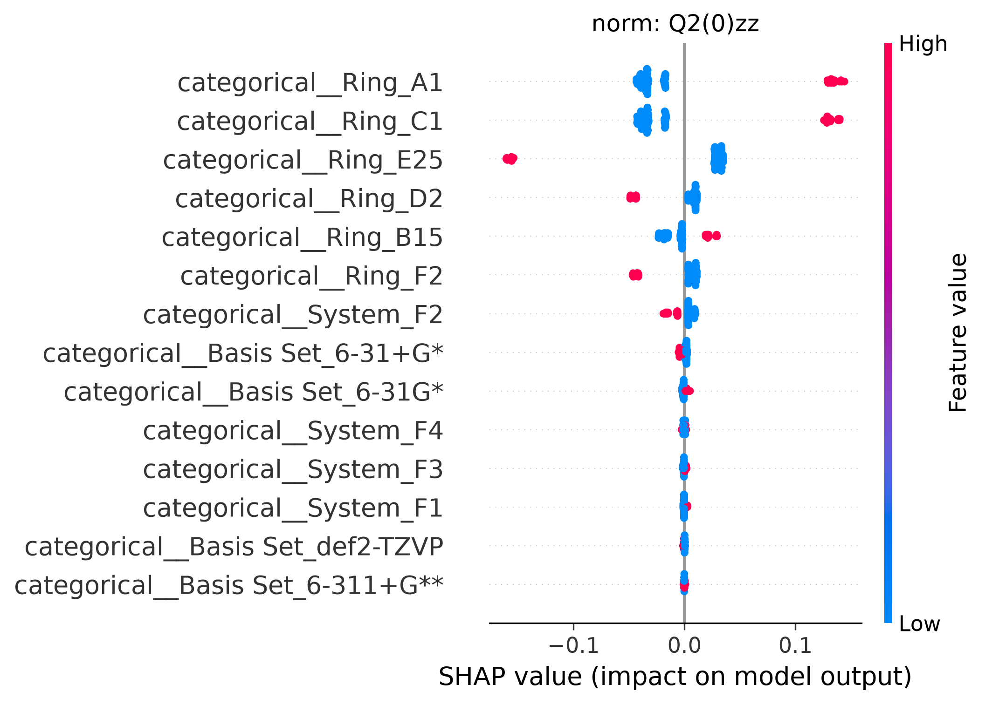
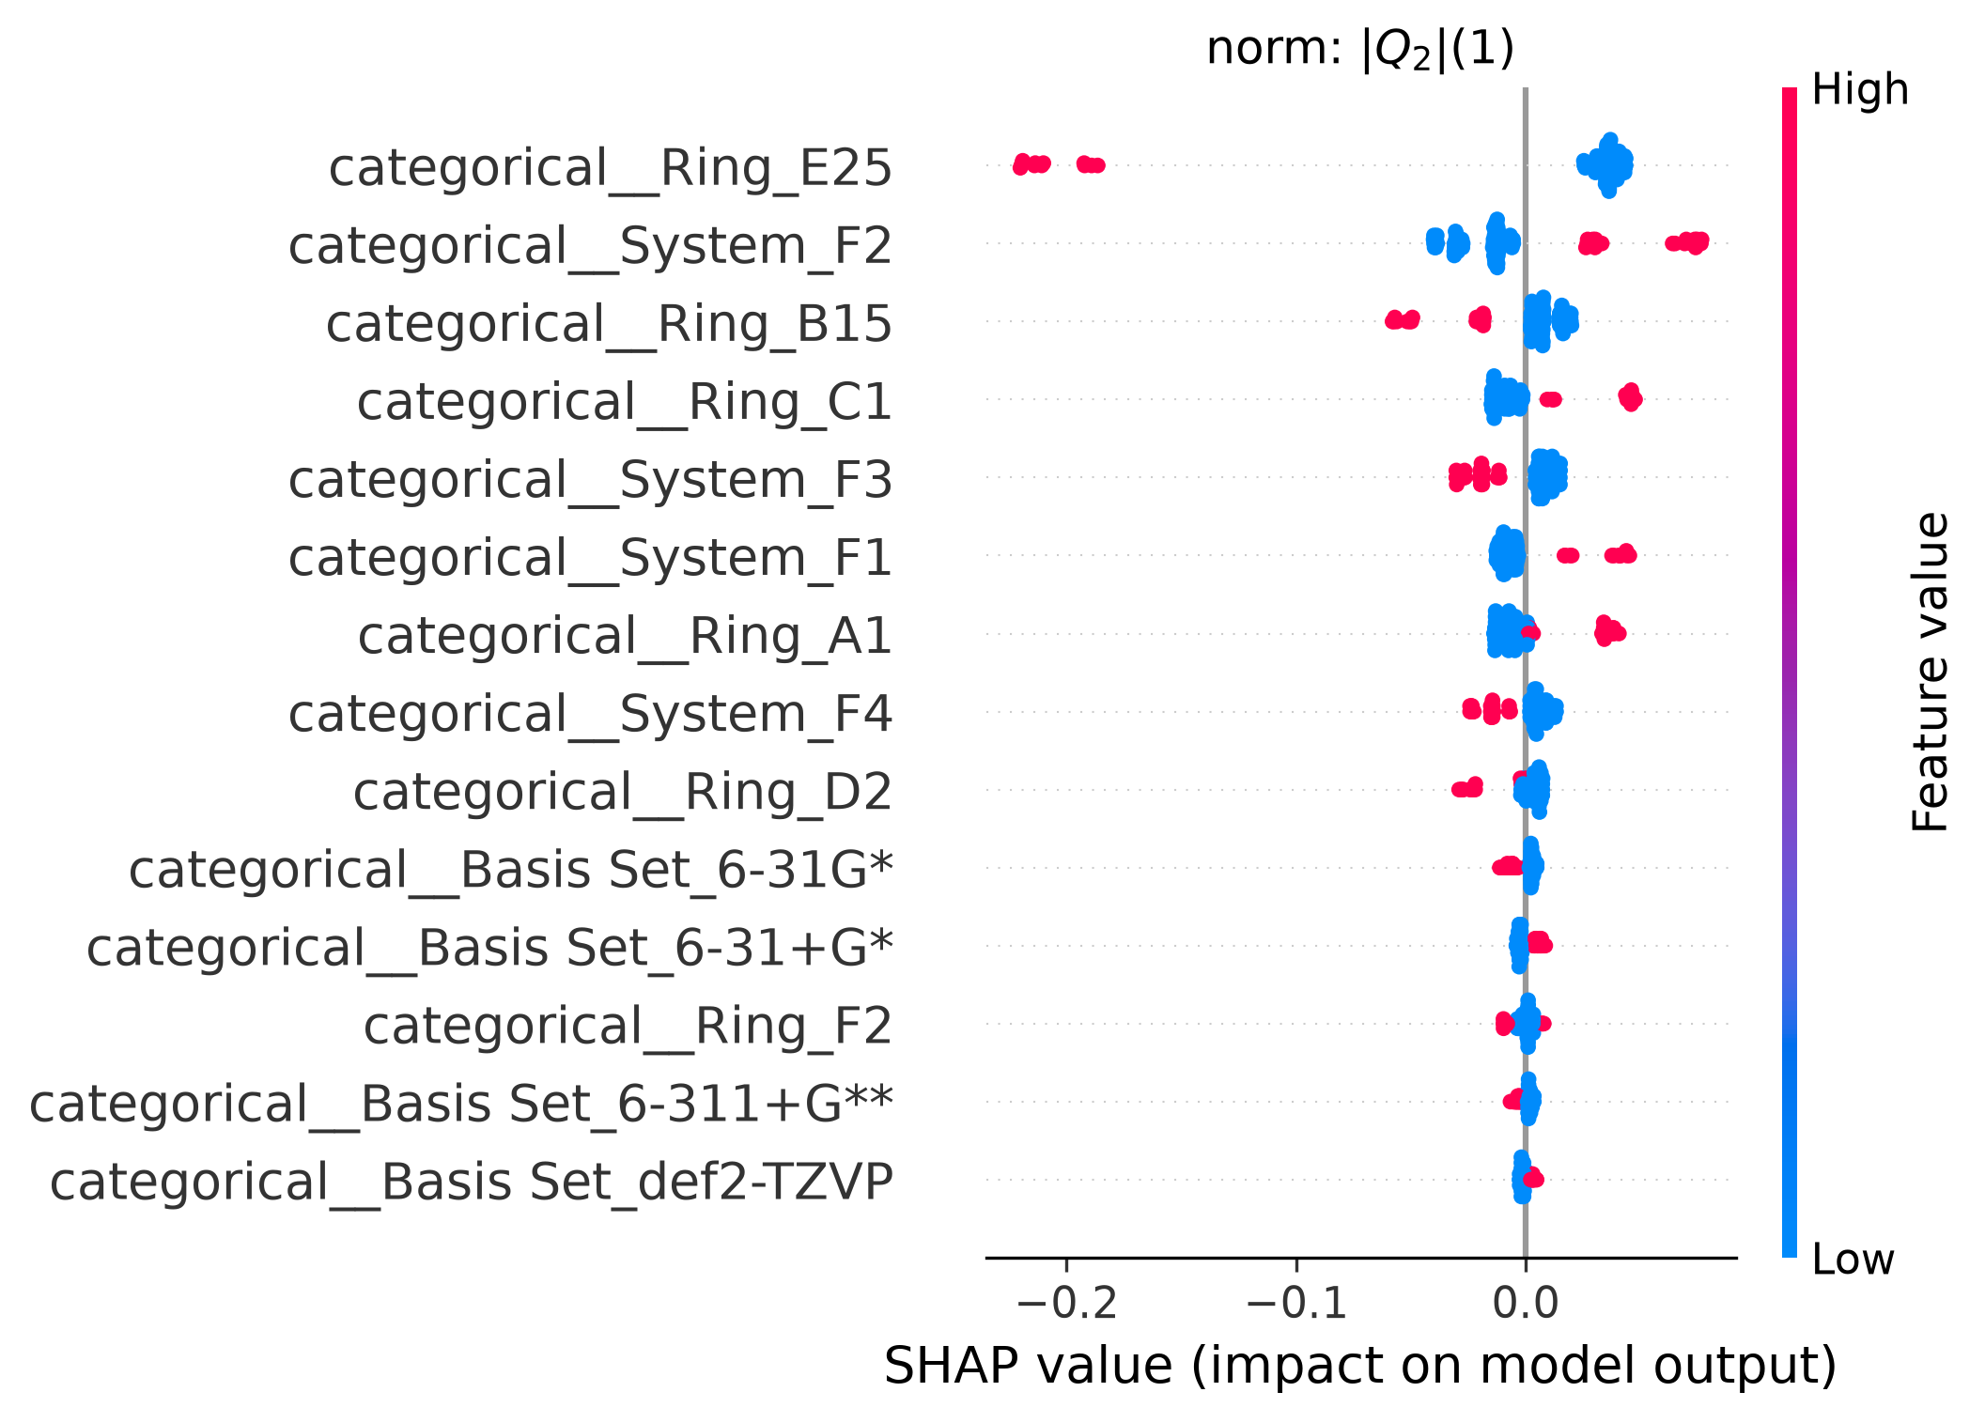
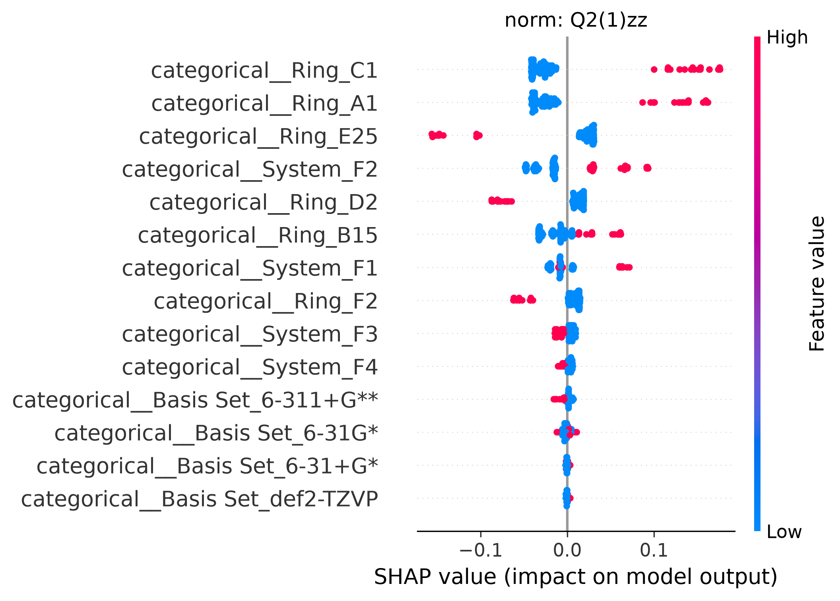
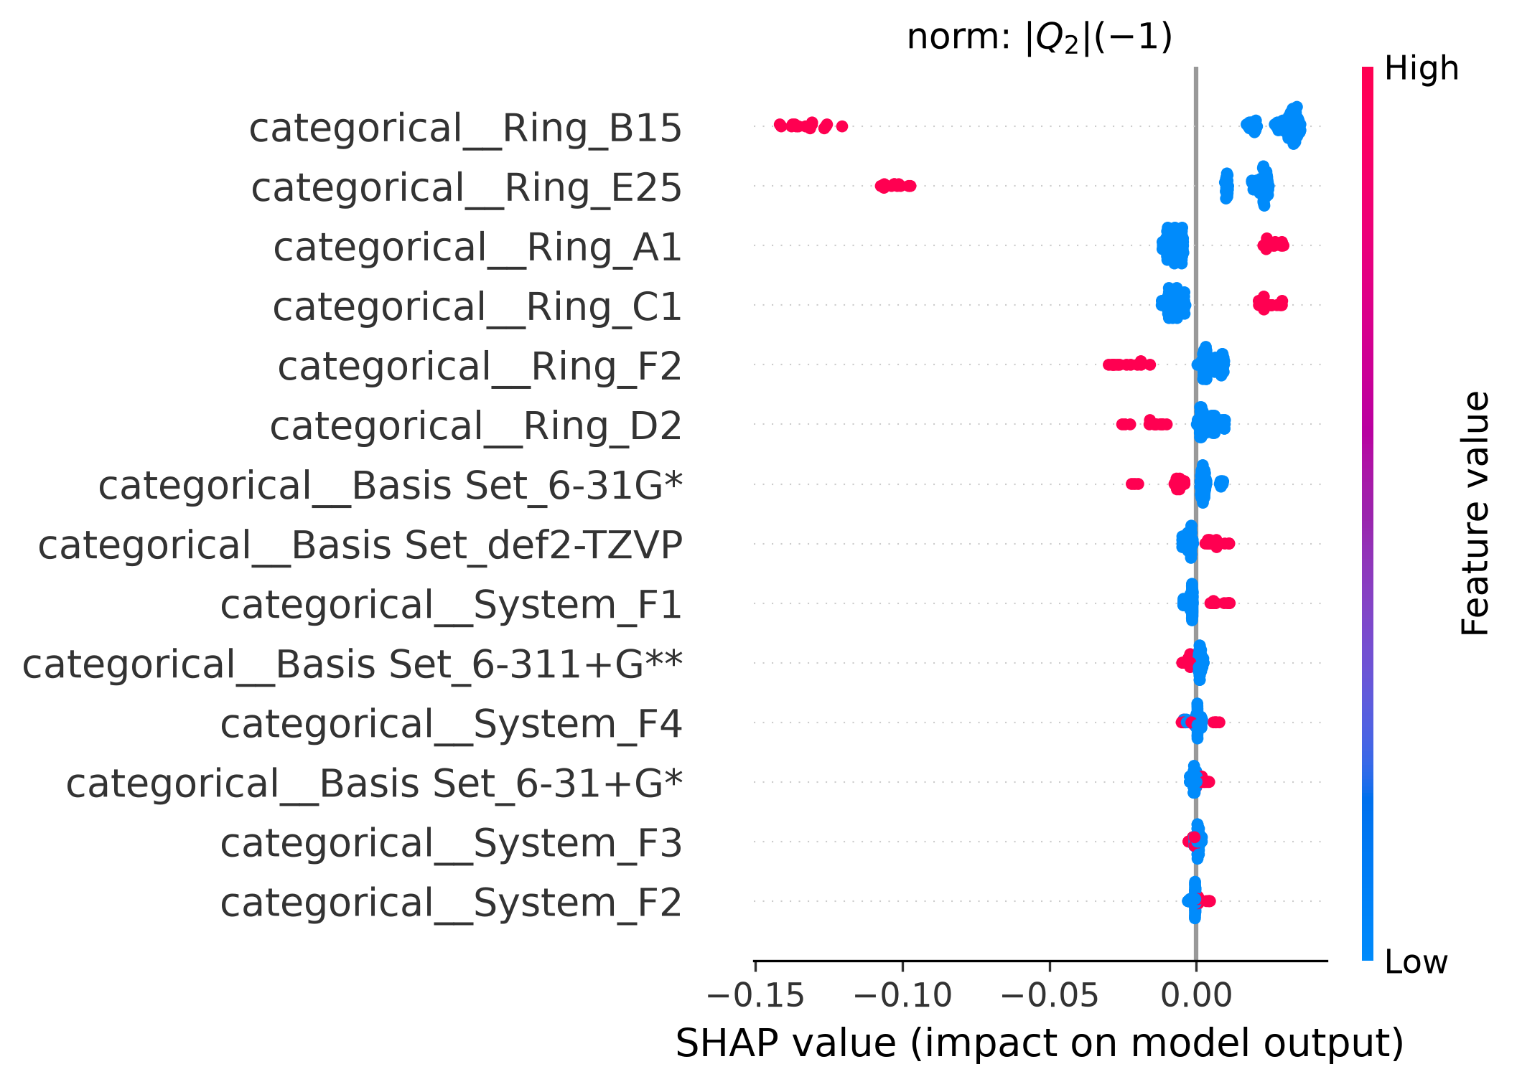
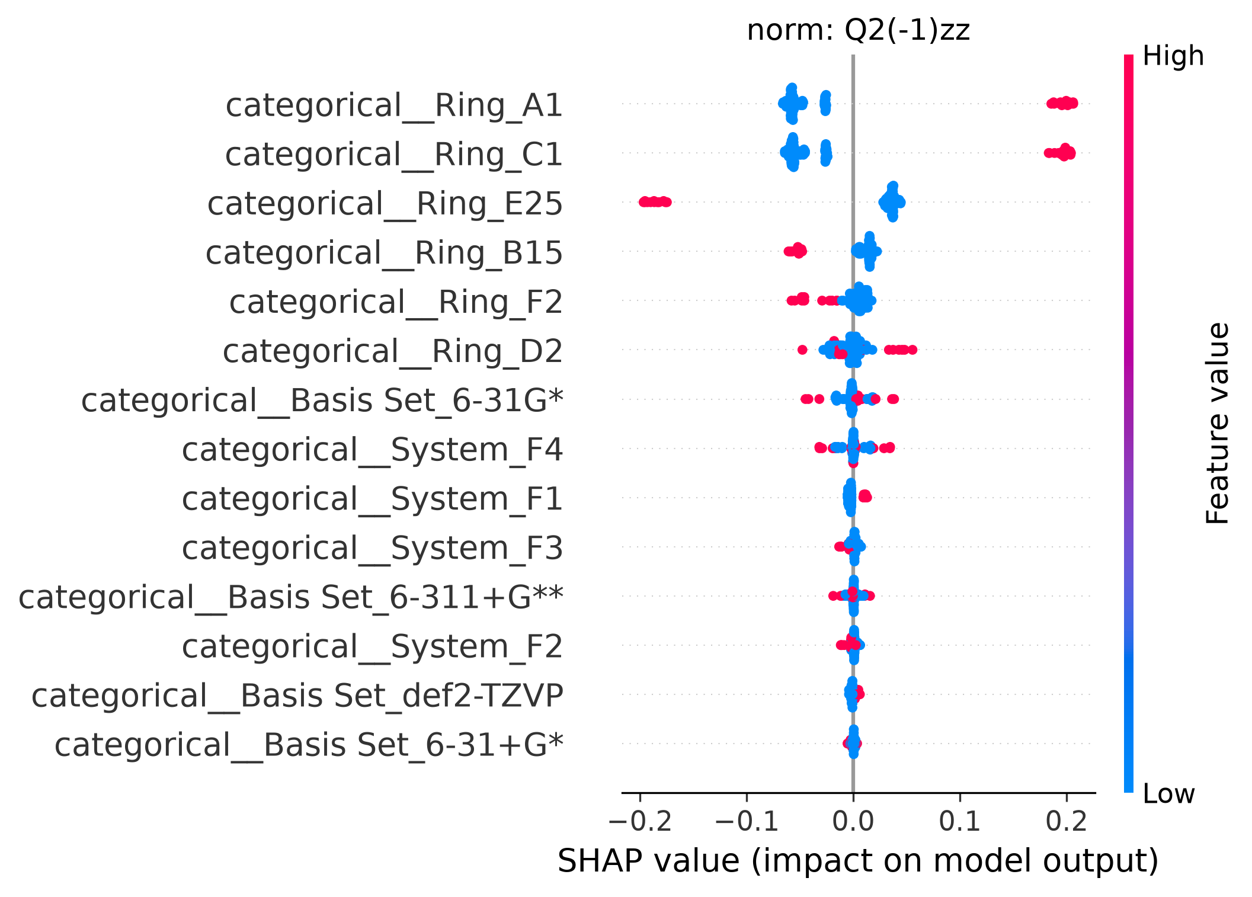








a)
$${\left|Q_{2}\right|}_{ring atoms}$$
$$Q_{2_{zz},ring atoms}$$
b)
c)
$$\left|Q_{2}\right|\left(0\right)$$
d)
$$Q_{2}{\left(0\right)}_{zz}$$
e)
$$\left|Q_{2}\right|\left(1\right)$$
f)
$$Q_{2}{\left(1\right)}_{zz}$$
g)
$$\left|Q_{2}\right|(−1)$$
h)
$$Q_{2}{\left(−1\right)}_{zz}$$

